Slide 1
Some and any
Basic 05 – Unit 3a

Slide 2
Some : affirmative sentences
Any : negative sentences, questions
I have some oranges
I need some lemons for my pie
I see some pens on the table
Do we need any yogurt?
Yes, we need some.
Do you have any bananas?
No, I don’t have any
No I don have any bananas
Do we need any water?
No, we don’t need any.

Slide 3
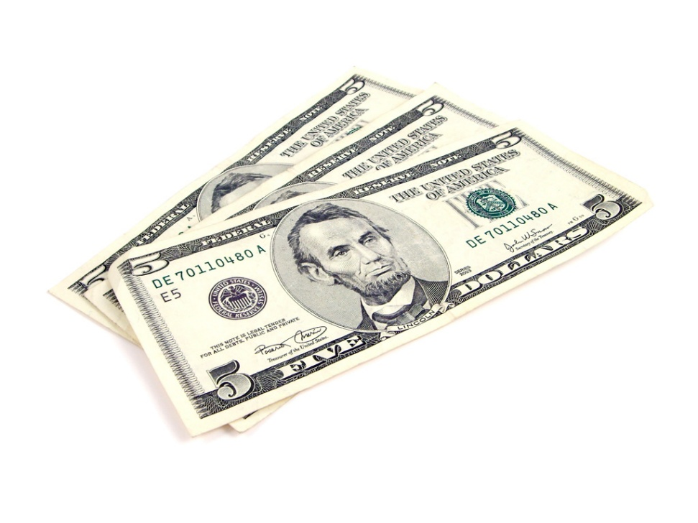
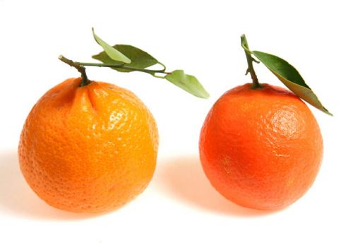
Much : Uncountable nouns
Many : Countable nouns
How much money do you have?
I don’t have much money. ☹
How many oranges do you have?
I have two oranges. ☺

Slide 4

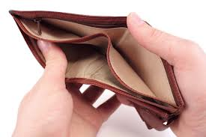
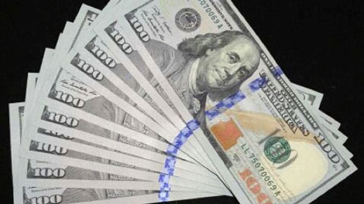
Example
There is some money . | There isn’t much money.
There isn´t any money | There is a lot of money.

Slide 5
Time to practice ☺
We need ______ bananas.
You can’t buy ____ apples in this store.
She always puts _____ sugar in her coffee.
There are _____ onions on the table.
Pam does not have ____ juice in her glass.
Do you have _____ lucumas ?
Are there _____ magazines on the desk?
I want _____ salt for my avocado please.
Complete the sentences with some or any.

Slide 6
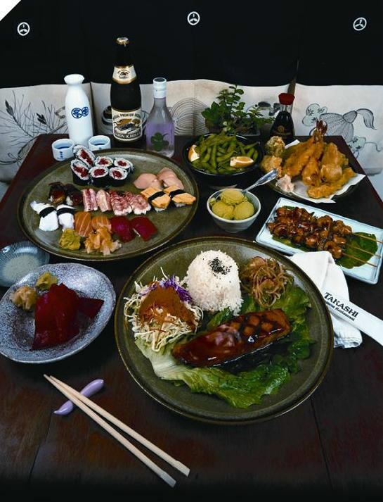
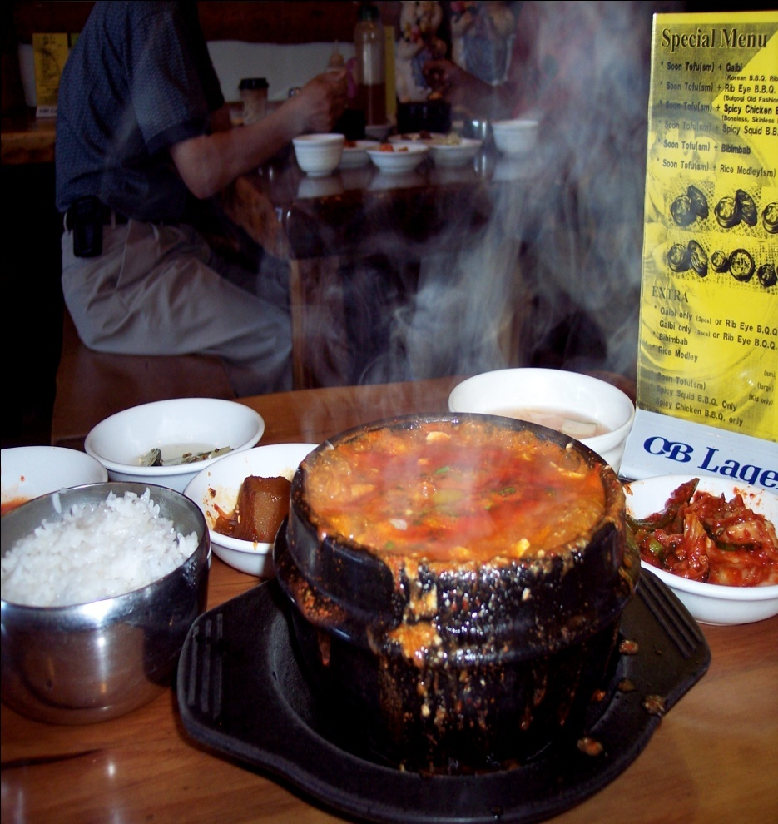
There is a lot of soup
There is a lot of food

Slide 7
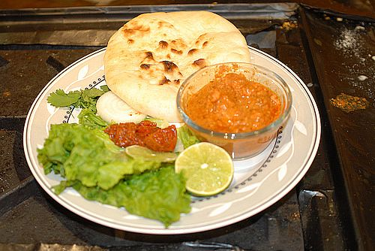
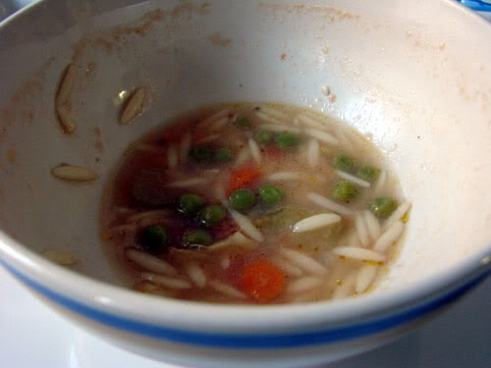
There is some food.
There isn’t much soup in the bowl.

Slide 8
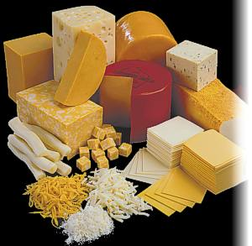
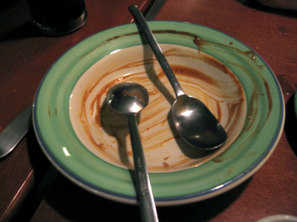
There isn’t any soup in the bowl
There is a lot of cheese

Slide 9
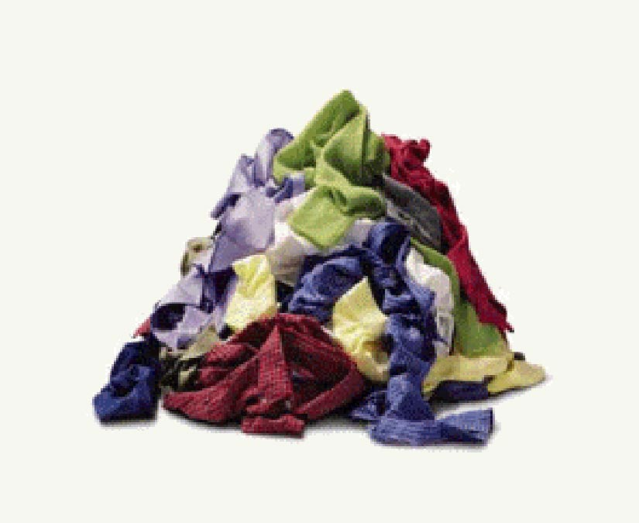
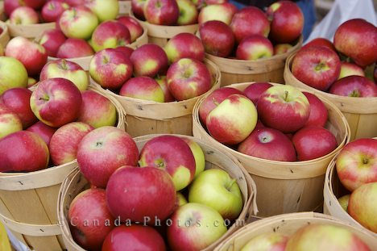
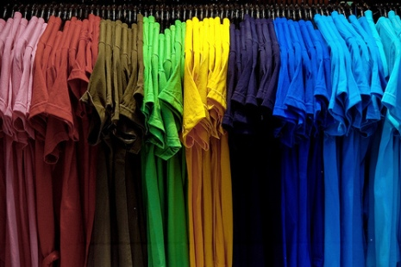
There are a lot of t-shirts
There are a lot of apples

Slide 10
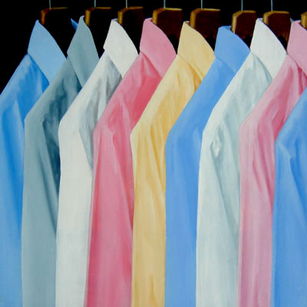
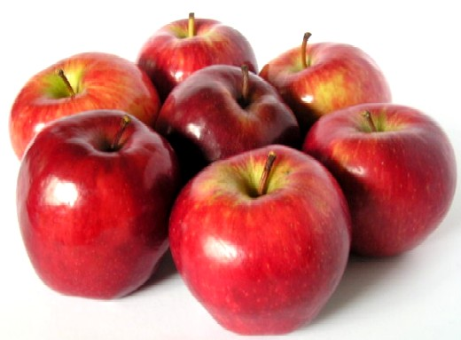
There are some shirts
There are some apples

Slide 11

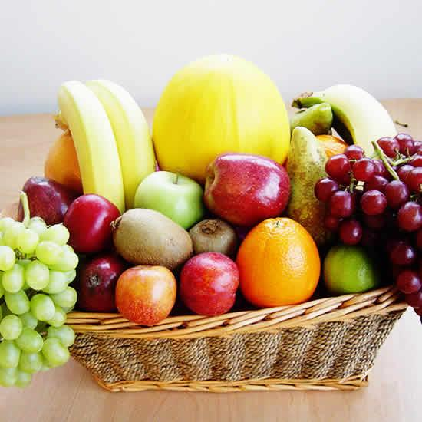
There aren’t many t-shirts
There aren’t many bananas

Slide 12
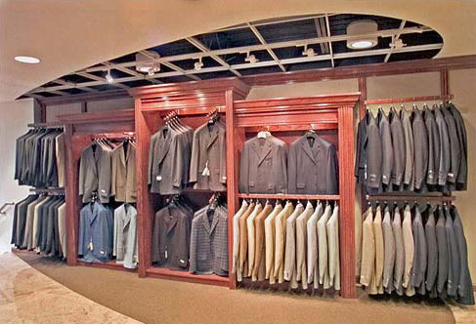
There aren’t any t-shirts

Slide 13
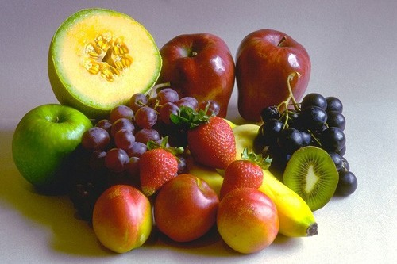
There aren’t any lucumas on the table.

Slide 14
What do we have for the fruit salad?
We have_______________________

